Slide 1
Final Robot Competition (ME 5751 SP 2025)
When: 9:30-10:05pm, April. 17th, Thursday
Where: classroom
Who: ME 5751 class, all teams
Field size: one letter size 8.5”x11” (215.9mm x 279.4 mm)
Container size: 100mm(W)x100mm(L)x50mm(H)
See the attached field setup sheet for details

Slide 2
Competition Rules
Basic Rules
Pick and place an object and drop it into a designated container
The coordinates of the objects and the container/holder is given in prior
Pick and place as many as possible objects in a given time window
The robot should be pre-programmed to conduct the task automatically. Once it is set, no one can touch the robot or the object.
You can restart the program and the field setup as long as the time is not used up.
There are three rounds (maximum 120+60+80=260 points)
Round #1 (3 tasks):
90s for each task. The preparation time is not counted
Each team can choose your own order
The final score is the total of all 3 tasks
Round #2: (1 task).
4 Randomly selected objects.
90s. The preparation time is not counted
Round #3: (1 task)
Pen picking
Curve tracing
Pen returning
Grading rule:
Ranking by total # of points earned
The first place receive a score of 100/100,
The last place receive a score of 70-85/100 (depends on the quality)
Team between the first and the last will receive a score by interpolating between 70-100.
The team who could not enter the competition receive 70/100

Slide 3
Dimensions of field setup for round 1 & 2
A letter size paper
Container box is 100mmx100mm
Objects are placed at the center of the four circles
Each circle is 30mm in diameter
Container box

Slide 4
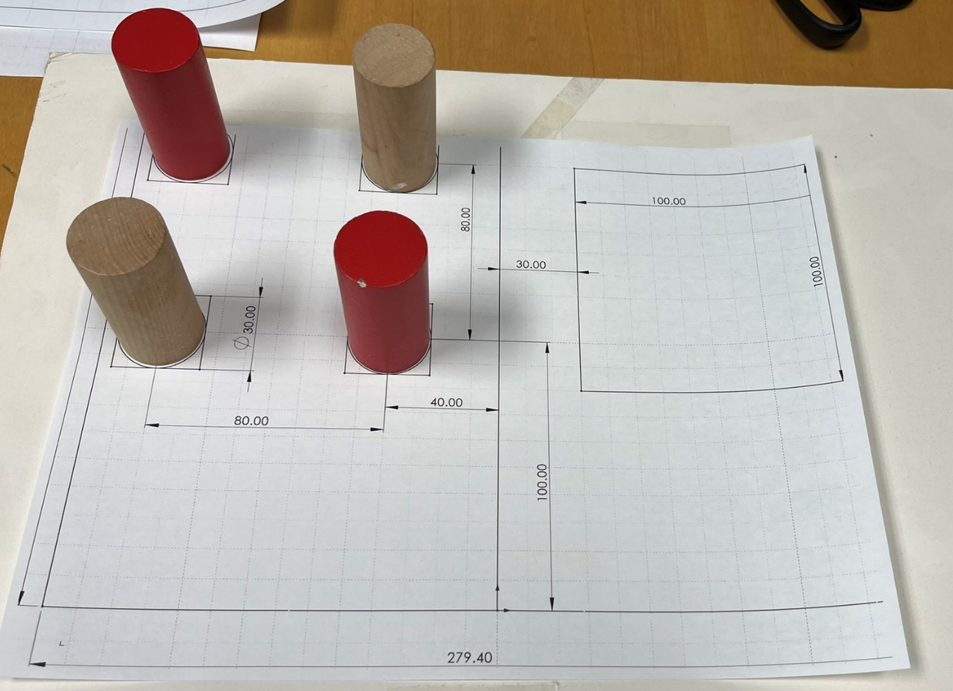
Round #1: Task #1
Four identical cylinders:
30mm diameter
60mm height
Total time: 90 secs
10 points if picking and placing each object into the container successfully
Maximum points: 40

Slide 5
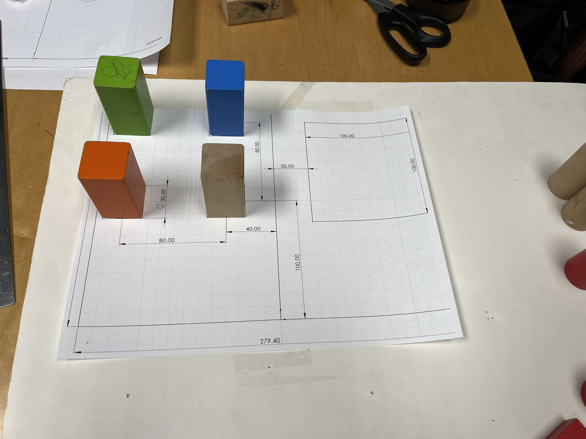
Round #1: Task #2
Four identical square block:
30x30mm
60mm height
Total time: 90 secs
10 points if picking and placing each object into the container successfully
Maximum points: 40

Slide 6
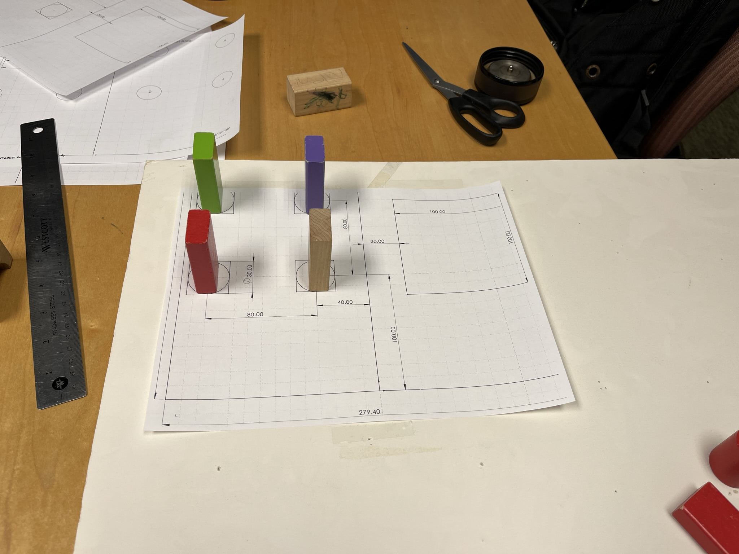
Round #1: Task #3
Four identical rectangular block:
15x30mm
60mm height
Total time: 90 secs
10 points if picking and placing each object into the container successfully
Maximum points: 40

Slide 7
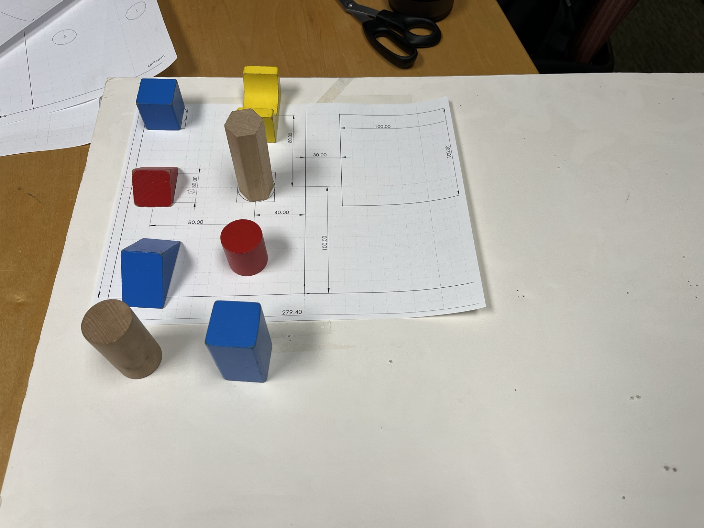
Round #2
4 randomly selected objects at a random position
Triangular prism, hexagon, bridge, cylinder, rectangular box etc.
Size: 30-60mm
Height: 30-90mm
Total time: 90 secs
15 points if picking and placing each object successfully
Maximum points: 60

Slide 8
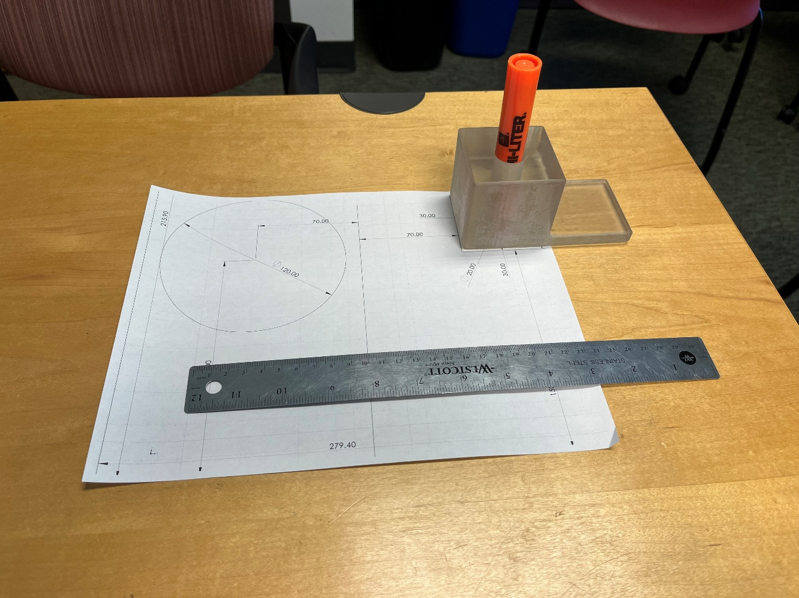
Round #3: Pen Picking and Curve Tracing
Robot grasps a marker pen (see dimensions from the next slide) from a pen holder: 20 points
Robot use the pen to trace a curve on the field paper (letter size)
40 points: a circle (see dimensions in the next slide)
Judge deduct points (2pts each time) if the pen tip is not aligning within +-5mm of the curve.
Robot place it back into the pen holder
20 points
As an option, you can skip picking and/or placing pen task.
Total time: 120 secs
Maximum points: 80

Slide 9
Dimensions of field setup for round 3
Circle to trace
Pen holder
A letter size paper
The pen holder box is 60mm (W)x60mm(L)x60mm(H)
Pen is about 20mm diameter and 130mm long and is inserted into the pen hold with the head pointing down.
The curve to be traced is a circle on the paper.
It is not required that the pen head must touch the field plane, preferably leaving about 10mm distance from the plane

